Slide 1
Javascript

Slide 2
Client Side Scripting
Notes:
client-side script: code runs in browser after page is sent back from server
often this code manipulates the page or responds to user actions

Slide 3
What is Javascript?
a lightweight programming language ("scripting language")
used to make web pages interactive
insert dynamic text into HTML (ex: user name)
react to events (ex: page load user click)
get information about a user's computer (ex: browser type)
perform calculations on user's computer (ex: form validation)

Slide 4
What is Javascript?
a web standard (but not supported identically by all browsers)
NOT related to Java other than by name and some syntactic similarities

Slide 5
JavaScript
JavaScript is a front-end scripting language developed by Netscape for dynamic content
Lightweight, but with limited capabilities
Can be used as object-oriented language
Client-side technology
Embedded in your HTML page
Interpreted by the Web browser
Simple and flexible

Slide 6
JavaScript Advantages
JavaScript allows interactivity such as:
Implementing form validation
React to user actions, e.g. handle keys
Changing an image on moving mouse over it
Sections of a page appearing and disappearing
Content loading and changing dynamically
Performing complex calculations
Custom HTML controls, e.g. scrollable table
Implementing AJAX functionality

Slide 7
JavaScript confusion
JavaScript | Java
Interpreted by the client-side computer | Compiled on the server before executed on the client machine
Dynamic binding, object references are checked at runtime | Static binding, object references must exist at compile time
No need to declare data types | Data types must be declared
Code is embedded in HTML | Code is not integrated in HTML
Limited by the browser functionality | Java applications are standalone
Can access browser objects | Java has no access to browser objects

Slide 8
document Methods
document.write() like a print statement – the output goes into the HTML document.
document.writeln() adds a newline after printing.
document.write("My title is" + document.title);

Slide 9
Example
<HEAD>
<TITLE>JavaScript is Javalicious</TITLE>
</HEAD>
<BODY>
<H3>I am a web page and here is my name:</H3>
<SCRIPT>
document.write(document.title);
</SCRIPT>
<HR>

Slide 10
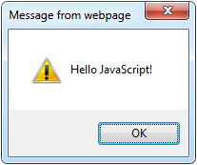
The First Script
first-script.html
<html>
<body>
<script type="text/javascript">
alert('Hello JavaScript!');
</script>
</body>
</html>

Slide 11
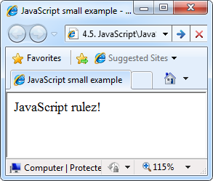
Another Small Example
small-example.html
<html>
<body>
<script type="text/javascript">
document.write('JavaScript rulez!');
</script>
</body>
</html>

Slide 12
Using JavaScript Code
The JavaScript code can be placed in:
<script> tag in the head
<script> tag in the body – not recommended
External files, linked via <script> tag the head
Files usually have .js extension
Highly recommended
The .js files get cached by the browser
<script src="scripts.js" type="text/javscript">
<!– code placed here will not be executed! -->
</script>

Slide 13
JavaScript – When is Executed?
JavaScript code is executed during the page loading or when the browser fires an event
All statements are executed at page loading
Some statements just define functions that can be called later
Function calls or code can be attached as "event handlers" via tag attributes
Executed when the event is fired by the browser
<img src="logo.gif" onclick="alert('clicked!')" />

Slide 14
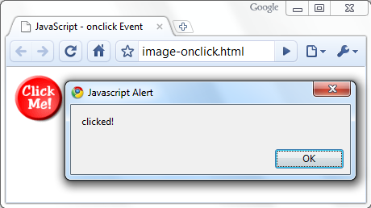
Calling a JavaScript Function from Event Handler – Example
<html>
<head>
<script type="text/javascript">
function test (message) {
alert(message);
}
</script>
</head>
<body>
<img src="logo.gif"
onclick="test('clicked!')" />
</body>
</html>
image-onclick.html

Slide 15
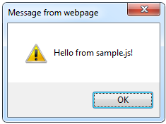
Using External Script Files
Using external script files:
External JavaScript file:
<html>
<head>
<script src="sample.js" type="text/javascript">
</script>
</head>
<body>
<button onclick="sample()" value="Call JavaScript
function from sample.js" />
</body>
</html>
external-JavaScript.html
The <script> tag is always empty.
function sample() {
alert('Hello from sample.js!')
}
sample.js

Slide 16
Standard Popup Boxes
Alert box with text and [OK] button
Just a message shown in a dialog box:
Confirmation box
Contains text, [OK] button and [Cancel] button:
Prompt box
Contains text, input field with default value:
alert("Some text here");
confirm("Are you sure?");
prompt ("enter amount", 10);

Slide 17
Using the alert() Method
<head>
<script language=“JavaScript”>
alert(“An alert triggered by JavaScript”);
</script>
</head>
It is the easiest methods to use amongst alert(), prompt() and confirm().
You can use it to display textual information to the user (simple and concise).
The user can simply click “OK” to close it.

Slide 18
Using the confirm() Method
<head>
<script language=“JavaScript”>
confirm(“Are you happy with the class?”);
</script>
</head>
This box is used to give the user a choice either OK or Cancel.
It is very similar to the “alert()” method.
You can also put your message in the method.

Slide 19
Using the prompt() Method
<head>
<script language=“JavaScript”>
prompt(“What is your student id number?”);
prompt(“What is your name?”,”No name”);
</script>
</head>
This is the only one that allows the user to type in his own response to the specific question.
You can give a default value to avoid displaying “undefined”.

Slide 20
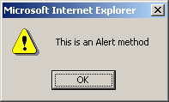
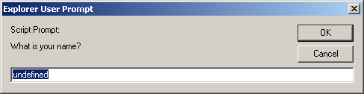
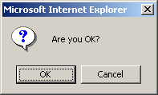
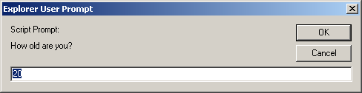
Three methods
<script language="JavaScript">
alert("This is an Alert method");
confirm("Are you OK?");
prompt("What is your name?");
prompt("How old are you?","20");
</script>

Slide 21
Example
<head>
<script language=“JavaScript”>
var id;
id = prompt(“What is your student id number?”);
alert(id);
name = prompt(“What is your name?”,”No name”);
alert(name);
</script>
</head>
Variable declaration

Slide 22
Sum of Numbers – Example
sum-of-numbers.html
<html>
<head>
<title>JavaScript Demo</title>
<script type="text/javascript">
function calcSum() {
value1 =
parseInt(document.mainForm.textBox1.value);
value2 =
parseInt(document.mainForm.textBox2.value);
sum = value1 + value2;
document.mainForm.textBoxSum.value = sum;
}
</script>
</head>

Slide 23
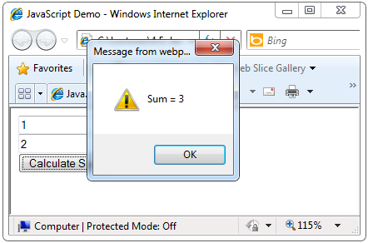
Sum of Numbers – Example
sum-of-numbers.html (cont.)
<body>
<form name="mainForm">
<input type="text" name="textBox1" /> <br/>
<input type="text" name="textBox2" /> <br/>
<input type="button" value="Process"
onclick="javascript: calcSum()" />
<input type="text" name="textBoxSum"
readonly="readonly"/>
</form>
</body>
</html>

Slide 24
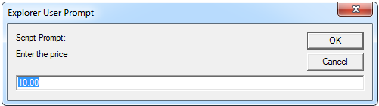
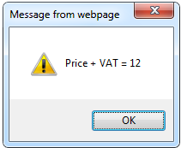
JavaScript Prompt – Example
prompt.html
price = prompt("Enter the price", "10.00");
alert('Price + VAT = ' + price * 1.2);

Slide 25
JavaScript Syntax
The JavaScript syntax is similar to C# and Java
Data Types
Operators (+, *, =, !=, &&, ++, …)
Conditional statements (if, else)
Looping Statements (for, while)
Arrays (my_array[]) and associative arrays (my_array['abc'])
Functions (can return value)

Slide 26
Data Types
JavaScript allows the same variable to contain different types of data values.
Primitive data types
Number: integer & floating-point numbers
Boolean: logical values “true” or “false”
String: a sequence of alphanumeric characters
Composite data types (or Complex data types)
Object: a named collection of data
Array: a sequence of values
Special data types
Null: an initial value is assigned
Undefined: the variable has been created by not yet assigned a value

Slide 27
Data types
JavaScript uses the var keyword to declare variables.
An equal sign is to assign values to variables.
Strings are written inside double or single quotes. Numbers are written without quotes.
If you put a number in quotes, it will be treated as a text string.
JavaScript is Case Sensitive
var lastname, lastName; lastName = "Doe"; lastname = "Peterson";

Slide 28
Integer and Floating-point number example
<script language=“JavaScript”>
var integerVar = 100;
var floatingPointVar = 3.0e10;
// floating-point number 30000000000
document.write(integerVar);
document.write(floatingPointVar);
</script>
The integer 100 and the number 30,000,000,000 will be appeared in the browser window.

Slide 29
Boolean value example
<head>
<script language=“JavaScript”>
var result;
result = (true*10 + false*7);
alert(“true*10 + false*7 = “, result);
</script>
</head>
The expression is converted to
(1*10 + 0*7) = 10
They are automatically converted.

Slide 30
String
String type – string of characters
String can also be enclosed in single quotation marks (‘) or in double quotation marks (“).
var myName = "You can use both single or double quotes for strings";

Slide 31
Strings example
<head>
<script language=“JavaScript”>
document.write(“This is a string.”);
document.write(“This string contains ‘quote’.”);
var myString = “My testing string”;
alert(myString);
</script>
</head>
Unlike Java and C, JavaScript does not have a single character (char) data type.

Slide 32
String Operations
The + operator joins strings
What is "9" + 9?
Converting string to number:
string1 = "fat ";
string2 = "cats";
alert(string1 + string2); // fat cats
alert("9" + 9); // 99
alert(parseInt("9") + 9); // 18

Slide 33
Strings: Extracting part of a string
There are 3 methods for extracting a part of a string:
slice(start, end)
substring(start, end)
substr(start, length)

Slide 34
Strings - slice
var str = "Apple, Banana, Kiwi"; var res = str.slice(7, 13);
o/p: Banana
If a parameter is negative, the position is counted from the end of the string.
var str = "Apple, Banana, Kiwi"; var res = str.slice(-12, -6);
o/p: Banana

Slide 35
Strings - substr
var str = "Apple, Banana, Kiwi"; var res = str.substr(7, 6);
o/p: Banana
substr() is similar to slice().
The difference is that the second parameter specifies the length of the extracted part.

Slide 36
Strings - substring
substring() is similar to slice().
The difference is that substring() cannot accept negative indexes.

Slide 37
Strings: charAt
Strings: Replace
The replace() method replaces a specified value with another value in a string:
str = "Please visit Microsoft!"; var n = str.replace("Microsoft", "W3Schools");
The charAt() method returns the character at a specified index (position) in a string:
var str = "HELLO WORLD"; str.charAt(0); // returns H

Slide 38
Strings – UpperCase and LowerCase
A string is converted to upper case with toUpperCase():
var text1 = "Hello World!"; // String var text2 = text1.toUpperCase(); // text2 is text1 converted to upper
A string is converted to lower case with toLowerCase():
var text1 = "Hello World!"; // String var text2 = text1.toLowerCase(); // text2 is text1 converted to lower

Slide 39
String: indexOf() and lastIndexOf()
Search a string
var str = "Hello world, welcome to the universe."; var n = str.indexOf("welcome");
The result of n will be: 13
Search a string for the last occurrence of a string
var str = "Hello planet earth, you are a great planet."; var n = str.lastIndexOf("planet");
The result of n will be: 36
Both methods return -1 if the value to search for never occurs.

Slide 40
Everything is Object
Every variable can be considered as object
For example strings and arrays have member functions:
objects.html
var test = "some string";
alert(test[7]); // shows letter 'r'
alert(test.charAt(5)); // shows letter 's'
alert("test".charAt(1)); //shows letter 'e'
alert("test".substring(1,3)); //shows 'es'
var arr = [1,3,4];
alert (arr.length); // shows 3
arr.push(7); // appends 7 to end of array
alert (arr[3]); // shows 7

Slide 41
Arrays
Arrays
Associative arrays (hash tables)
var my_array = [1, 5.3, "aaa"];
var my_hash = {a:2, b:3, c:"text"};

Slide 42
Arrays Operations and Properties
Declaring new empty array:
Declaring an array holding few elements:
Appending an element / getting the last element:
Reading the number of elements (array length):
Finding element's index in the array:
var arr = new Array();
var cars = new Array("Saab", "Volvo", "BMW");
var arr = [1, 2, 3, 4, 5];
arr.push(3);
var element = arr.pop();
arr.length;
arr.indexOf(1);

Slide 43
Array Example
<script language=“JavaScript”>
Car = new Array(3);
Car[0] = “Ford”;
Car[1] = “Toyota”;
Car[2] = “Honda”;
document.write(Car[0] + “<br>”);
document.write(Car[1] + “<br>”);
document.write(Car[2] + “<br>”);
</script>
You can also declare arrays with variable length.
arrayName = new Array();
Length = 0, allows automatic extension of the length.
Car[9] = “Ford”; Car[99] = “Honda”;

Slide 44
Null & Undefined
An “undefined” value is returned when you attempt to use a variable that has not been defined or you have declared but you forgot to provide with a value.
Null refers to “nothing”
You can declare and define a variable as “null” if you want absolutely nothing in it, but you just don’t want it to be “undefined”.

Slide 45
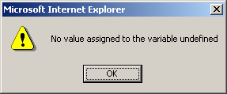
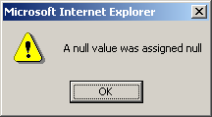
Null & Undefined example
<html>
<head>
<title> Null and Undefined example </title>
<script language=“JavaScript”>
var test1, test2 = null;
alert(“No value assigned to the variable” + test1);
alert(“A null value was assigned” + test2);
</script>
</head>
<body> … </body>
</html>

Slide 46
JavaScript Special Characters
Character | Meaning
\b | Backspace
\f | Form feed
\t | Horizontal tab
\n | New line
\r | Carriage return
\\ | Backslash
\’ | Single quote
\” | Double quote

Slide 47
Operators
Arithmetic operators
Logical operators
Comparison operators
String operators
Bit-wise operators
Assignment operators
Conditional operators

Slide 48
Arithmetic operators
left_operand “operator” right_operand
Operator | Name | Description | Example
+ | Addition | Adds the operands | 3 + 5
- | Subtraction | Subtracts the right operand from the left operand | 5 - 3
* | Multiplication | Multiplies the operands | 3 * 5
/ | Division | Divides the left operand by the right operand | 30 / 5
% | Modulus | Calculates the remainder | 20 % 5

Slide 49
typeof operator
<head>
<script language=“JavaScript”>
var x = “hello”, y;
alert(“Variable x value is “ + typeof(x));
alert(“Variable y value is “ + typeof(y));
alert(“Variable x value is “ + typeof(z));
</script>
</head>
It is an unary operator.
Return either: Number, string, Boolean, object, function, undefined, null

Slide 50
Unary and Binary Operators
Binary operators take two operands.
Unary type operators take only one operand.
Name | Example
Post Incrementing operator | Counter++
Post Decrementing operator | Counter--
Pre Incrementing operator | ++counter
Pre Decrementing operator | --counter

Slide 51
Logical operators
Used to perform Boolean operations on Boolean operands
Operator | Name | Description | Example
&& | Logical and | Evaluate to “true” when both operands are true | 3>2 && 5<2
|| | Logical or | Evaluate to “true when either operand is true | 3>1 || 2>5
! | Logical not | Evaluate to “true” when the operand is false | 5 != 3

Slide 52
Comparison operators
Used to compare two numerical values
Operator | Name | Description | Example
== | Equal | Perform type conversion before checking the equality | “5” == 5
=== | Strictly equal | No type conversion before testing | “5” === 5
!= | Not equal | “true” when both operands are not equal | 4 != 2
!== | Strictly not equal | No type conversion before testing nonequality | 5 !== “5”
> | Greater than | “true” if left operand is greater than right operand | 2 > 5
< | Less than | “true” if left operand is less than right operand | 3 < 5
>= | Greater than or equal | “true” if left operand is greater than or equal to the right operand | 5 >= 2
<= | Less than or equal | “true” if left operand is less than or equal to the right operand | 5 <= 2

Slide 53
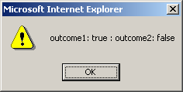
Strict Equality Operators
<script language=“JavaScript”>
var currentWord=“75”;
var currentValue=75;
var outcome1=(currentWord == currentValue);
var outcome2=(currentWord === currentValue);
alert(“outcome1: “ + outcome1 + “ : outcome2: “ + outcome2);
</script>

Slide 54
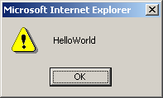
String operator
JavaScript only supports one string operator for joining two strings.
Operator | Name | Description | Return value
+ | String concatenation | Joins two strings | “HelloWorld”
<script language=“JavaScript”>
var myString = “”;
myString = “Hello” + “World”;
alert(myString);
</script>

Slide 55
Bit Manipulation operators
Perform operations on the bit representation of a value, such as shift left or right.
Operator | Name | Description
& | Bitwise AND | Examines each bit position
| | Bitwise OR | If either bit of the operands is 1, the result will be 1
^ | Bitwise XOR | Set the result bit, only if either bit is 1, but not both
<< | Bitwise left shift | Shifts the bits of an expression to the left
>> | Bitwise signed right shift | Shifts the bits to the right, and maintains the sign
>>> | Bitwise zero-fill right shift | Shifts the bits of an expression to right

Slide 56
Assignment operators
Used to assign values to variables
Operator | Description | Example
= | Assigns the value of the right operand to the left operand | A = 2
+= | Add the operands and assigns the result to the left operand | A += 5
-= | Subtracts the operands and assigns the result to the left operand | A -= 5
*= | Multiplies the operands and assigns the result to the left operand | A *= 5
/= | Divides the left operands by the right operand and assigns the result to the left operand | A /= 5
%= | Assigns the remainder to the left operand | A %= 2

Slide 57
JavaScript Statements
JavaScript statements are separated by semicolon
Conditional statements
Looping statements

Slide 58
Conditional Statement
“if … else” statement
“switch” statement

Slide 59
“if … else” statement
if (condition) { statement; }
else if (condition) { statement; }
else { statement; }

Slide 60
Conditional Statement (if)
unitPrice = 1.30;
if (quantity > 100) {
unitPrice = 1.20;
}
Symbol
Meaning
>
Greater than
<
Less than
>=
Greater than or equal to
<=
Less than or equal to
==
Equal
!=
Not equal

Slide 61

Conditional Statement (if) (2)
The condition may be of Boolean or integer type:
conditional-statements.html
var a = 0;
var b = true;
if (typeof(a)=="undefined" || typeof(b)=="undefined") {
document.write("Variable a or b is undefined.");
}
else if (!a && b) {
document.write("a==0; b==true;");
} else {
document.write("a==" + a + "; b==" + b + ";");
}

Slide 62
“switch” statement
switch (expression) {
case label1:
statements; break;
default:
statements;
}
Allows you to merge several evaluation tests of the same variable into a single block of statements.

Slide 63
Switch Statement
The switch statement works like in C#:
switch (variable) {
case 1:
// do something
break;
case 'a':
// do something else
break;
case 3.14:
// another code
break;
default:
// something completely different
}
switch-statements.html

Slide 64
“do … while” loop
do {
statements;
counter increment/decrement;
} while (termination condition)

Slide 65
Functions
Code structure – splitting code into parts
Data comes in, processed, result returned
function name(parameter1, parameter2, parameter3)
{ code to be executed }

Slide 66
Functions
Parameters come in here.
function average(a, b, c)
{
var total;
total = a+b+c;
return total/3;
}
Declaring variables is optional. Type is never declared.
Value returned here.

Slide 67
Example-1
<html>
<body>
<h1>JavaScript Functions</h1>
<p id="demo"></p>
<script>
function myFunction(a, b)
{
return a * b;
}
document.getElementById("demo").innerHTML = myFunction(4, 3);
</script>
</body>
</html>

Slide 68
Example-2
<html>
<body>
<p id="demo"></p>
<script>
document.getElementById("demo").innerHTML =
"The temperature is " + toCelsius(77) + " Celsius";
function toCelsius(fahrenheit)
{
return (5/9) * (fahrenheit-32);
}
</script>
</body>
</html>
Output:
The temperature is 25 Celsius

Slide 69
Function Arguments and Return Value
Functions are not required to return a value
When calling function it is not obligatory to specify all of its arguments
The function has access to all the arguments passed via arguments array
function sum() {
var sum = 0;
for (var i = 0; i < arguments.length; i ++)
sum += parseInt(arguments[i]);
return sum;
}
alert(sum(1, 2, 4));
functions-demo.html

Slide 70
Java Script Date
<!DOCTYPE html>
<html>
<body>
<p id="demo"></p>
<script>
document.getElementById("demo").innerHTML = Date();
</script>
</body>
</html>

Slide 71
Date and Time
<SCRIPT LANGUAGE = "JavaScript">
var current = new Date();
document.writeln(current);
document.writeln( "<H1>Get methods for local time zone</H1>" );
document.writeln( "getDate: " + current.getDate() +
"<BR>getDay: " + current.getDay() +
"<BR>getMonth: " + current.getMonth() +
"<BR>getFullYear: " + current.getFullYear() +
"<BR>getTime: " + current.getTime() +
"<BR>getHours: " + current.getHours() +
"<BR>getMinutes: " + current.getMinutes() +
"<BR>getSeconds: " + current.getSeconds() +
"<BR>getMilliseconds: " + current.getMilliseconds() +
"<BR>getTimezoneOffset: " + current.getTimezoneOffset() );

Slide 72
Date and Time
document.writeln( "<H1>Specifying arguments for a new Date</H1>" );
var D1 = new Date( 1999, 2, 18, 1, 5, 3, 9 );
document.writeln( "Date: " + D1 );
document.writeln( "<H1>Set methods for local time zone</H1>" );
D1.setDate( 31 );
D1.setMonth( 11 );
D1.setFullYear( 1999 );
D1.setHours( 23 );
D1.setMinutes( 59 );
D1.setSeconds( 59 );
document.writeln( "Modified date: " + D1 );
</SCRIPT>

Slide 73
Example - Date
new Date() puts the current time/date (from your computer) into the variable currentTime:
<script language="JavaScript">
currentTime=new Date();
if (currentTime.getHours() < 12)
document.greet.greetingbox.value="Good morning!"
else if (currentTime.getHours() < 17)
document.greet.greetingbox.value="Good afternoon!"
else document.greet.greetingbox.value="Good evening!"
</script>

